Slide 1


INSTACART ONLINE GROCERY SHOPPING
DATS 6101 – PROJECT 2
GROUP NAME – CHERRY
GROUP MEMBERS – Zichu Chen, Zixuan Huang, Ruth Akor, Qing Ruan, Kaiqi Yu

Slide 2
WHY IS THIS STUDY IMPORTANT?
HAVE YOU SHOPPED ONLINE BEFORE?
HAVE YOU BOUGHT GROCERIES ONLINE?

Slide 3
DATA DESCRIPTION
Data Source: Kaggle
Time Frame: 2017
Number of Observations: Over 3 million orders from 200,000 users
Dataset – consists of 6 csv files
Orders - gives a list of all orders
Products- contains the names of the products with their corresponding product id
Prior Orders - contains previous order contents for all customers
Train data for prior orders – Similar to prior orders but used for data training
Department – shows the different departments and products in each department
Aisles – shows the different aisles and products in each aisle

Slide 4
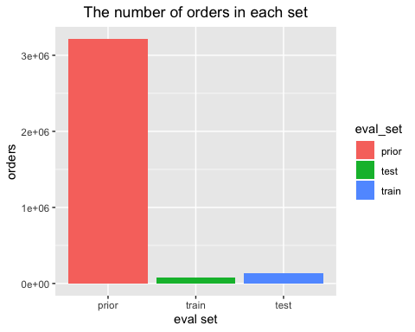
EXPLORATORY DATA ANALYSIS – ORDERS DATA
The data is divided into three sets
– prior, train and test
3214,784 orders belong to the prior set and the remaining orders which are the latest orders for each customer are separated into train set and test set.
The train set has 131,209 observations.
The test dataset has 75,000 observations.

Slide 5
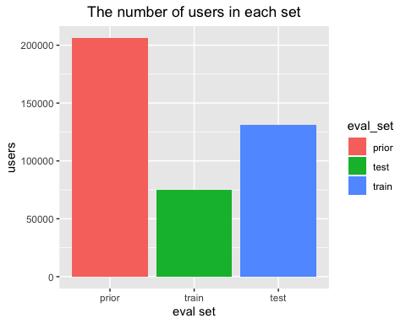
CUSTOMERS IN EACH SET
There are 206,209 customers in total. Out of which, the last purchase of 75,000 customers are given as train set and we will use this train set to build our models

Slide 6
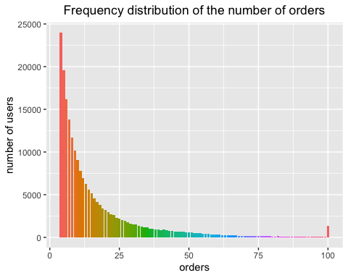
HOW MANY ORDERS DO CUSTOMERS PLACE?
Most customers have more than 4 orders and the maximum order per customer is 100

Slide 7
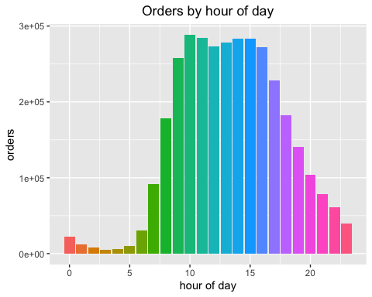
WHAT TIME OF THE DAY ARE ORDERS PLACED?
Orders are highest between 10am and 4pm although there is a slight decrease during lunch time (noon)

Slide 8
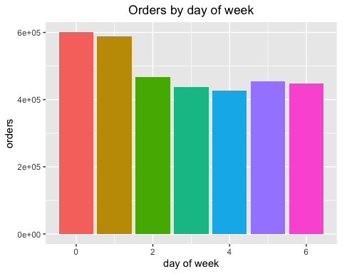
WHAT DAY OF THE WEEK ARE ORDERS PLACED?
O represents Saturday
1 represents Sunday
Orders are mostly placed during the weekend

Slide 9
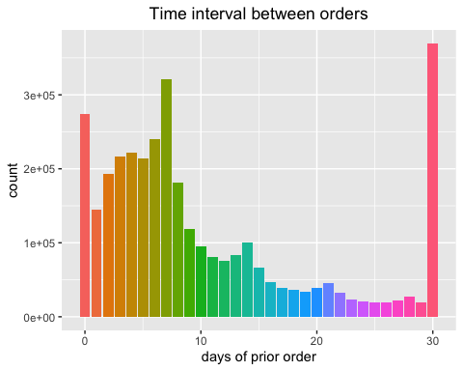
HOW OFTEN DO CUSTOMERS PLACE ORDERS?
Looks like customers order once in every week (check the peak at 7 days) or once in a month (peak at 30 days). We could also see smaller peaks at 14, 21 and 28 days (weekly intervals)

Slide 10
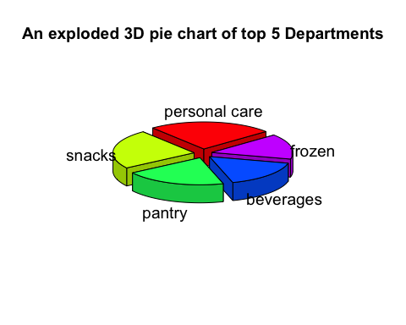
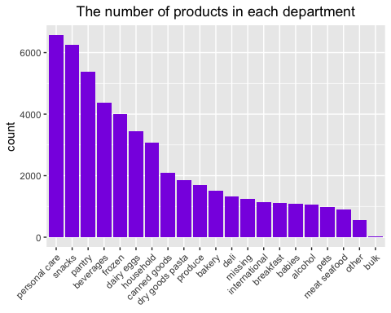
PRODUCTS & DEPARTMENTS and AISLES

Slide 11
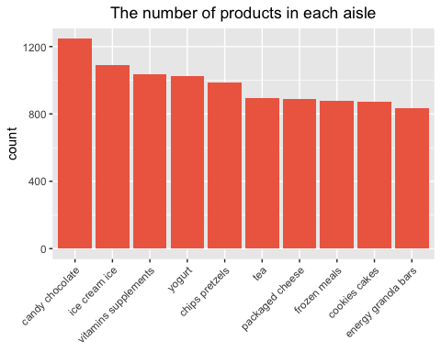
TOP 10 AISLES WITH HIGHEST PRODUCTS

Slide 12
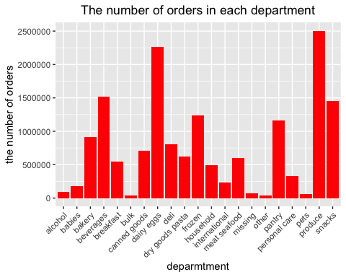
ORDERS, DEPARTMENTS & AISLES
The most three popular departments according to orders are produce, dairy eggs and beverages.

Slide 13
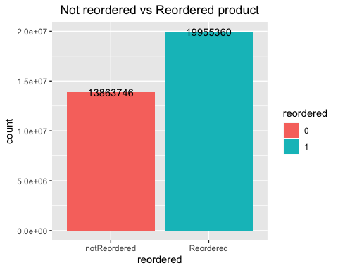
HOW MANY PRODUCTS ARE RE-ORDERED?

Slide 14
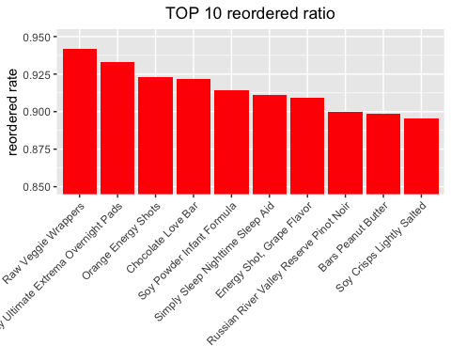
WHAT PRODUCTS ARE MOSTLY RE-ORDERED?

Slide 15
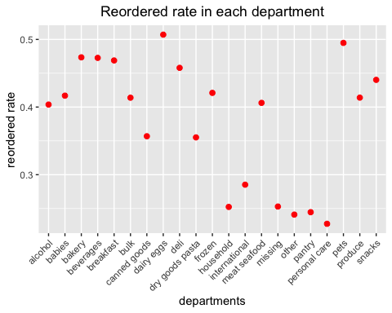
WHICH DEPARTMENT HAS THE HIGHEST AND LOWEST RE-ORDER RATIO?
Personal care has lowest reorder ratio and dairy eggs have highest reorder ratio.

Slide 16
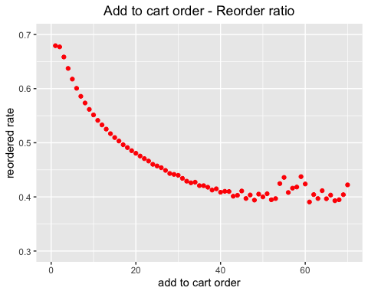
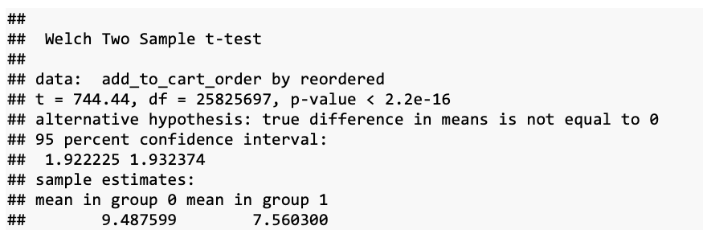
Is there any relationship between the sequence of adding to cart and a chance of re-ordering？
Products placed initially in the cart are more likely to be reordered than one placed later in the cart.
We can conclude from the results that the p-value is smaller than 0.05 which implies that the sequence of products adding to cart significantly influence whether the products are reordered

Slide 17
Smart Question: What Products Will The Customers Buy In Their Next Order?
Goal: Predict which previously purchased products will be in a user’s next order
0 means will not buy, 1 means will buy
15 Features we created

Slide 18
FEATURE SELECTION
User Features
Product Features
User and Product Features

Slide 19
USER FEATURES
n.o.u(feature1): The number of orders for each user
n.p.u(feature2): The number of products for each user
avg.pou(feature3): Average number of products per user ordered
d.m.p(feature4): The day on which each user ordered most frequently
t.m.o(feature5): The time of a day on which each user ordered most frequently
ror.u(feature6): Reordered ratio per user
o.f(feature7): Shopping frequency for each user

Slide 20
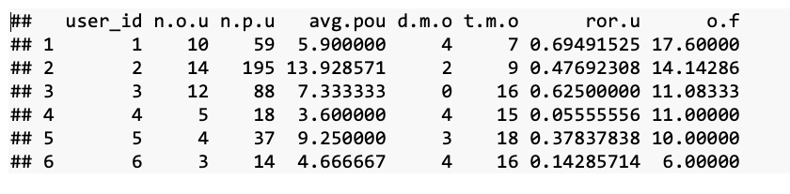
USER FEATURES
We combine all the user features above into a new data frame. ‘user_id’ is the key variable in this data frame.

Slide 21
PRODUCT FEATURES
n.o.p(feature8): Ordering frequency for each product.
ror.p(feature9): Reordered ratio for each product.
ror.pd(feature10): Average sequence in the cart for each product.
avg.p(feature11): Reordered ratio for each department

Slide 22
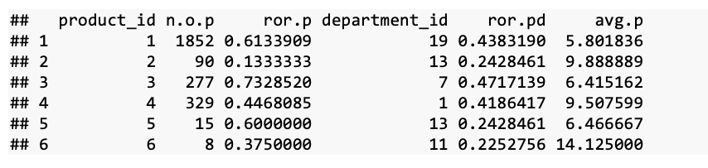
PRODUCT FEATURES
Next, we merged these product features together. ‘product_id’ is the key variable in this data frame.

Slide 23
USER & PRODUCT FEATURES
t.b(feature12): Times of each product bought by each user.
f.o.n(feature13): The order number in which customer bought the product.
ror.pu(feature14): The ratio at which each product is reordered by each user.
l4o(feature15): The ratio of each product bought in each user’s last four orders

Slide 24
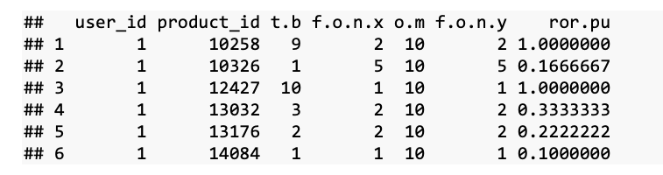
USER & PRODUCT FEATURES
Next, we merged these new features we just created

Slide 25
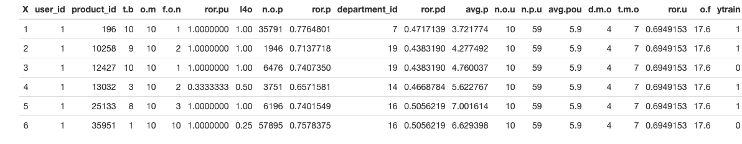
ALL 15 FEATURES
We used just records of the first 10,000 users because the dataset is very large. So, we now have 300,000 observations

Slide 26
MODELS
Logistic Regression: because our dependent variable is binary
PCA : To see whether those 15 features can be decomposed to several components
KNN and Decision Tree algorithms: because it is a classification question

Slide 27
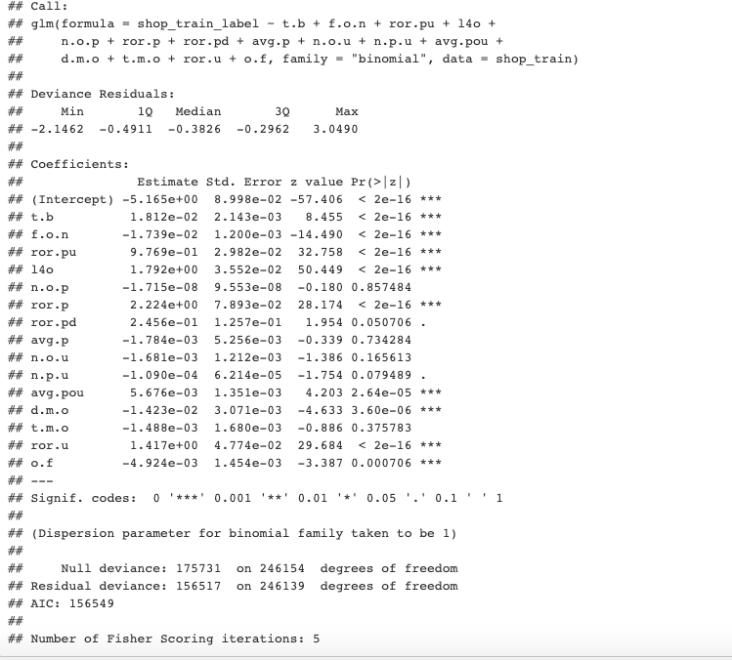
LOGISTIC REGRESSION
Split data into Train set (246155 observations) and Test set (61539 observations)
The results of the regression show that the following variables significantly influence the choice of customers in their next orders
t.b (times of each product bought by each user)
f.o.n (the order number in which customer bought the product)
ror.pu (the ratio at which each product is reordered by each user)
l4o (the ratio of each product bought in each user’s last four orders)
ror.p(reordered ratio for each product)
ror.pd (average sequence in the cart for each product)
avg.pou (average number of products per user ordered),
d.m.p (the day on which each user ordered most frequently),
ror.u (reordered ratio per user)
o.f(shopping frequency for each user)

Slide 28
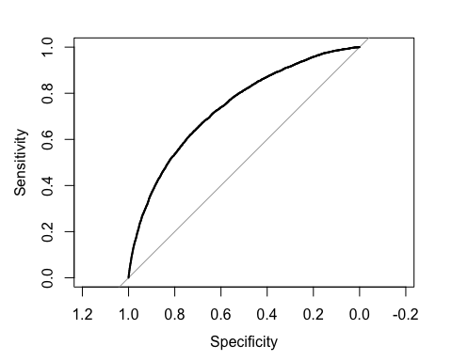
AREA UNDER THE CURVE
Since area under the curve is 0.74, which is smaller than 0.8. With the McFadden value, only 10.93% of target (will buy or not buy) is explained by the explanatory variables in the model. This model is not as good as we expected.

Slide 29
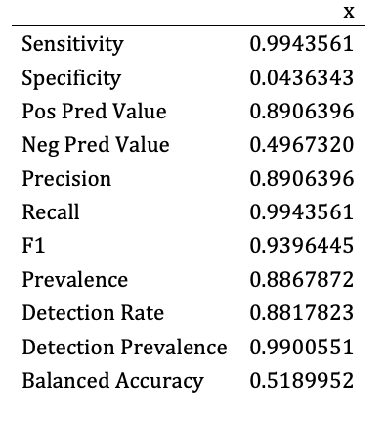
CONFUSION MATRIX
Using confusion matrix to calculate accuracy and other evaluation parameters, we found that the F1 score is 0.9396, the sensitivity (recall value) is 0.9944, the specificity is 0.0436, the accuracy is 0.8867 and the precision value is 0.8906.

Slide 30
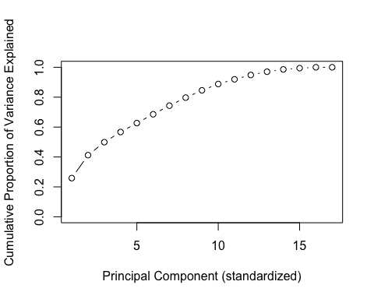
PCA
8 components of the standardized analysis compose around 80% of the variance
11 components compose approximate 90% of the variance
13 components carry 99% of the variance.
So the curve on the graph is gradually increasing, meaning that there is no one component that carries a lot of variance.

Slide 31
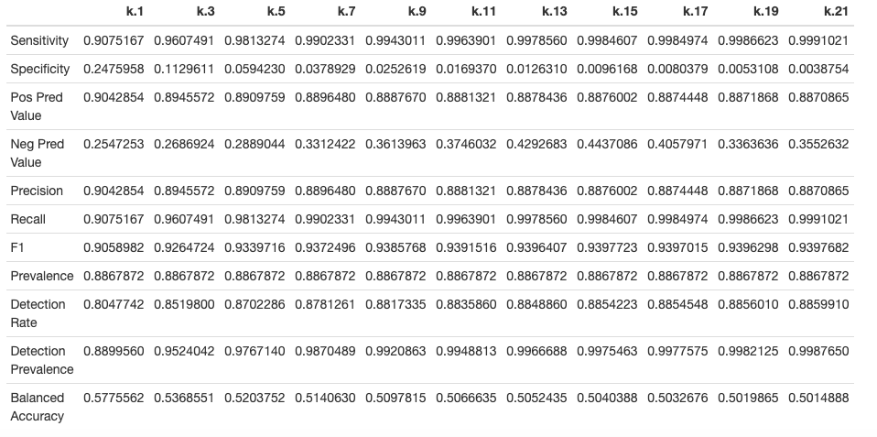
KNN
We built model from 1NN to 21NN (k is odd number) to see what is the best k value and used confusion Matrix for evaluation.

Slide 32
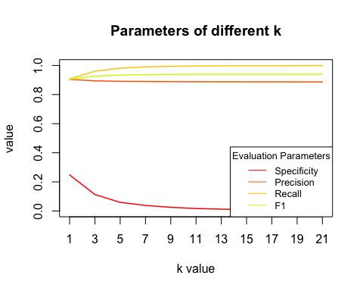
We tried k value as all odd numbers from 1 to 21, and found that when k value is 15, the F1 score is the highest, which is 0.9398. We chose a small k value to ensure the complexity of the model. It seems 15-nearest neighbors is a decent choice. In this case, the sensitivity is 0.9984, the specificity is 0.0096, the precision value is 0.8876. The accuracy is 0.8859.

Slide 33
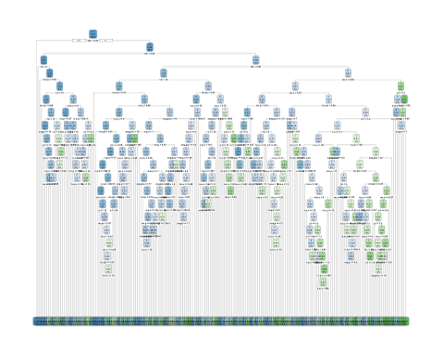
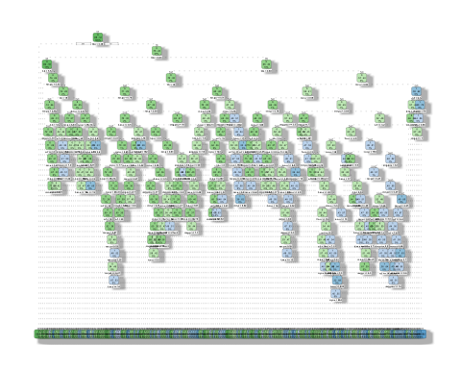
DECISION TREE
minbucket=20,cp=0.0001
minbucket: the minimum number of observations in any terminal <leaf> node
cp:complexity parameter. Any split that does not decrease the overall lack of fit by a factor of cp is not attempted

Slide 34
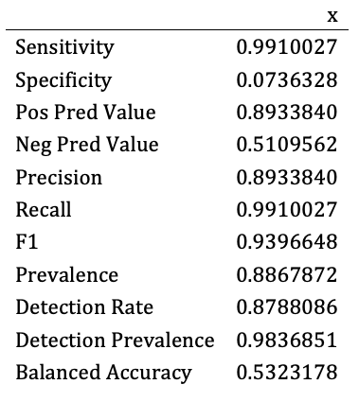
The result of decision tree model shows that the F1 score is 0.9397. We can also notice that sensitivity is (recall rate) is 0.9910, specificity is 0.0736, overall accuracy is 0.8871 and precision is 0.8933.

Slide 35
SUMMARY
 | Logistic Regression | KNN (K=15) | Decision Tree
F1 | 0.9673 | 0.9398 | 0.9397
Sensitivity | 0.9978 | 0.9984 | 0.9910
Specificity | 0.0283 | 0.0096 | 0.0736
Precision | 0.9387 | 0.8876 | 0.8933
Accuracy | 0.8867 | 0.8859 | 0.8871
Conclusion:
The F1 score of three models are very high and close.
All the specificity value are low.
Decision tree is better.
Notes:
All the specificity value are low. This indicates that the high accuracy is due to the high proportion of false negative, which means that we correctly predicted what kinds of products customers will not buy rather than they will buy. So, when it comes to what products the customer will buy next time, there are relatively small amount of cases in the model where the predicted value is the same as the observed value.

Slide 36
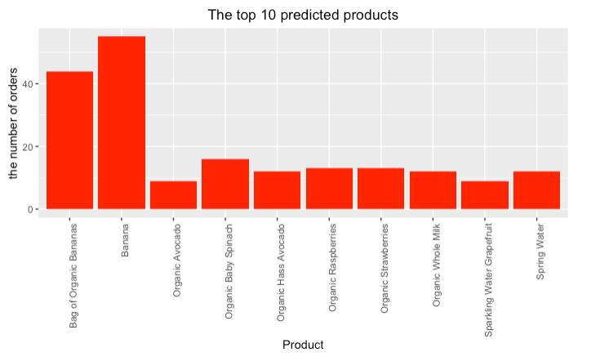
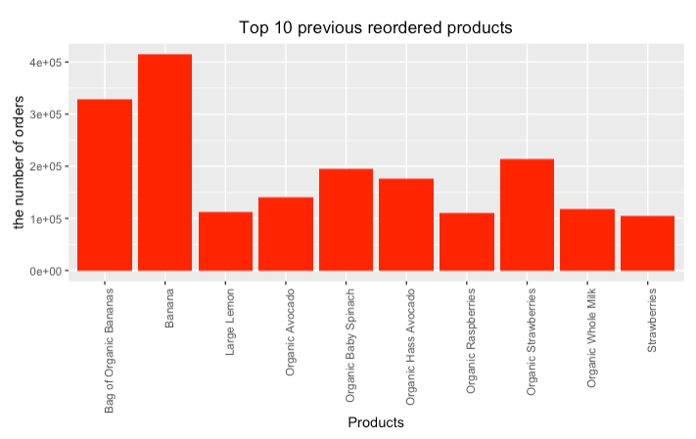
Prediction VS Observation

Slide 37
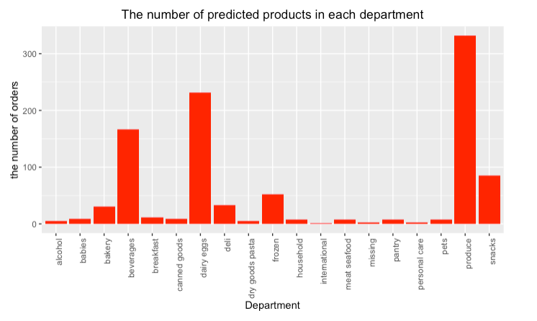
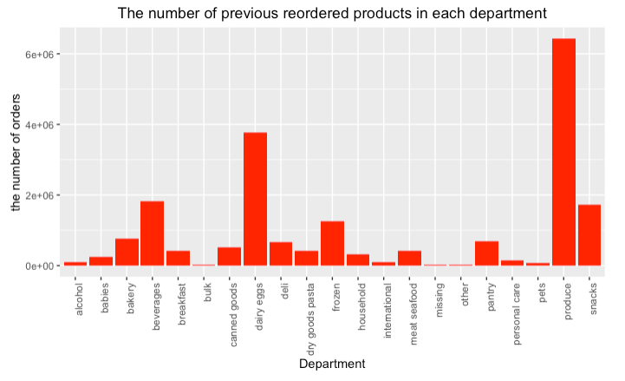
Prediction VS Observation
Conclusion:
The products we predict are basically the same as those people previous ordered.

Slide 38
LIMITATIONS
The values in the target are not evenly distributed, since there are only 35288 observations of 1 but 272406 observations of 0, obviously there are too many targets where values are 0. Maybe using oversampling method to improve it.
Due to the large amount of data, we only selected the first 10,000 users as our modeling sample. Although this is the easiest way to achieve subset, it may not be as appropriate as random sampling. However, users are independent with each other, so the way we select the data will not influence the modeling process.

Slide 39


